Slide 1
7 Repetition Structures(2) & more on Python Data Types
Instructor: Raed Karim
Email: raed.karim@sheridancollege.ca
Course: PROG12583

Slide 2
6 Repetition Structures

Slide 3
Repetition Structures
Objectives
At the end of this module, students will be able to:
Validate user inputs using loops.
Use loops to calculate running totals.
Implement a technique that stops a loop when processing a long sequence of values (Sentinels).
Implement techniques for additional control over loops (break and continue).
Define and implements python tuples and dictionaries.
Utilize tuples and dictionaries functions and methods.

Slide 4
Writing repetition structures using while loops Part - 1

Slide 5
Repetition Structures
Repetition Structures: validating user inputs
Input validation is the process of inspecting data that has been input to a program, to make sure it is valid before it is used in a computation.
Input validation is commonly done with a loop that iterates as long as an input variable references bad data.
One of the most famous sayings among computer programmers is “garbage in, garbage out.”
This saying, sometimes abbreviated as GIGO, refers to the fact that computers cannot tell the difference between good data and bad data. If a user provides bad data as input to a program, the program will process that bad data and, as a result, will produce bad data as output.

Slide 6
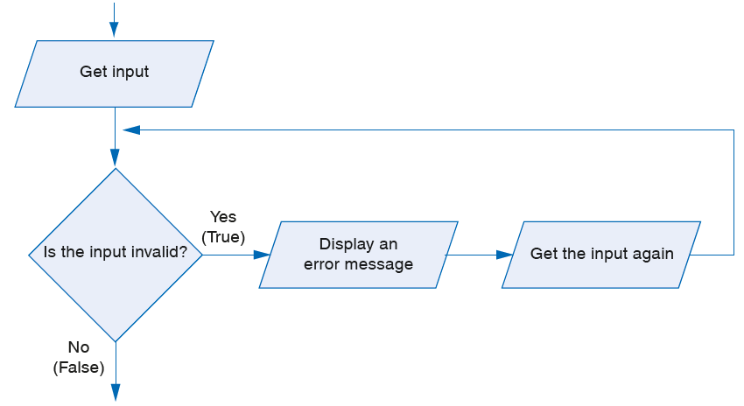
Repetition Structures
Repetition Structures: validating user inputs
Input validation is commonly done with a loop that iterates as long as input is bad.
The flowchart shows the logic containing an input validation loop.
Notice that we get the input again Inside the loop - that is giving users a new attempt to enter a new value to validate.

Slide 7
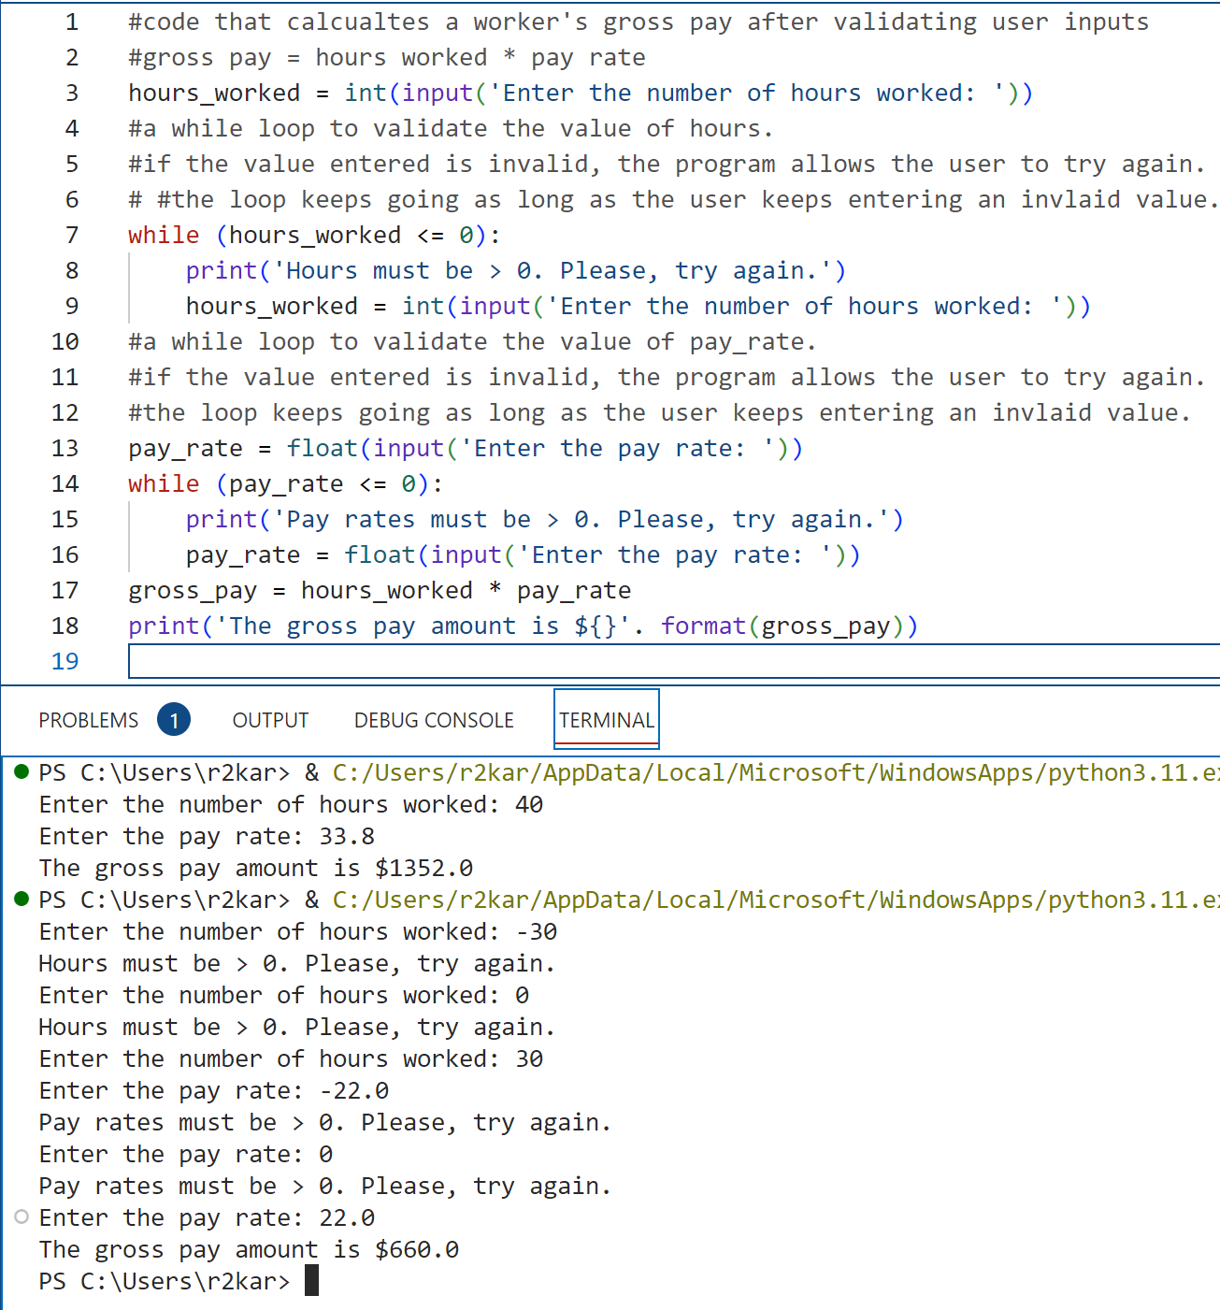
Repetition Structures
Repetition Structures: Example for validating user inputs

Slide 8
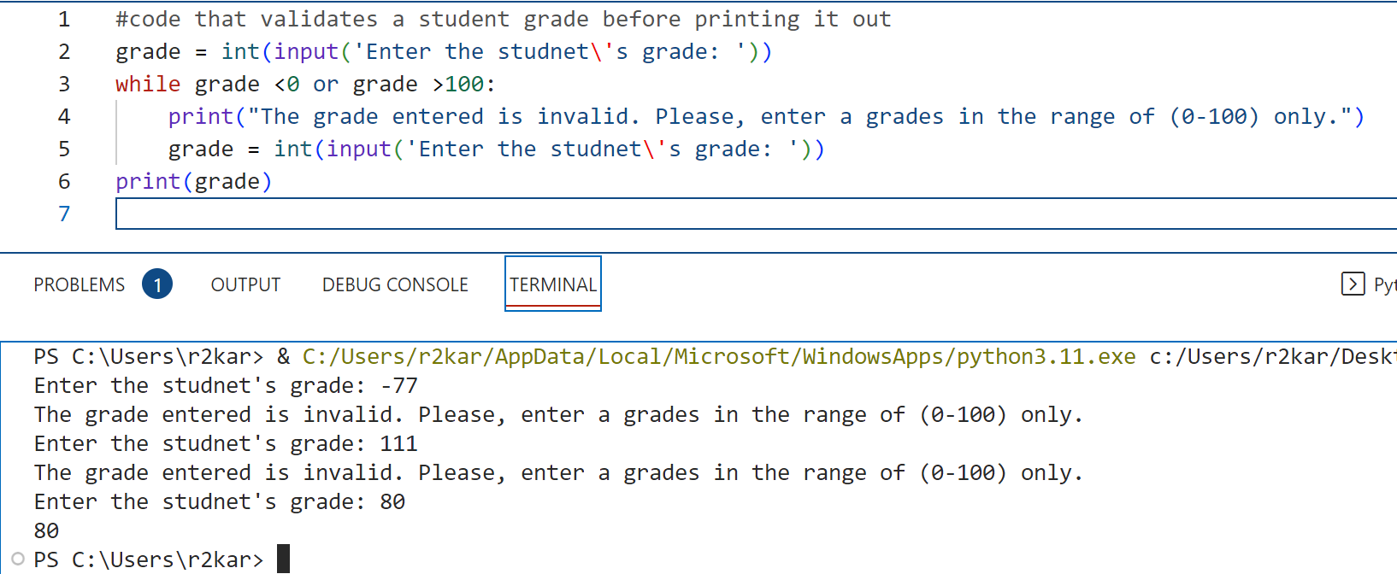
Repetition Structures
Repetition Structures: Example for validating user inputs

Slide 9
Repetition Structures
Repetition Structures: calculating running totals
A running total is a sum of numbers that accumulates with each iteration of a loop. The variable used to keep the running total is called an accumulator.
It is often said that the loop keeps a running total because it accumulates the total as it reads each number in the series.
For example, suppose you are writing a program that calculates a business’s total sales for a week. The program would read the sales for each day as input and calculate the total of those numbers.
Programs that calculate the total of a series of numbers typically use two elements:
A loop that reads each number in the series.
A variable that accumulates the total of the numbers as they are read.

Slide 10
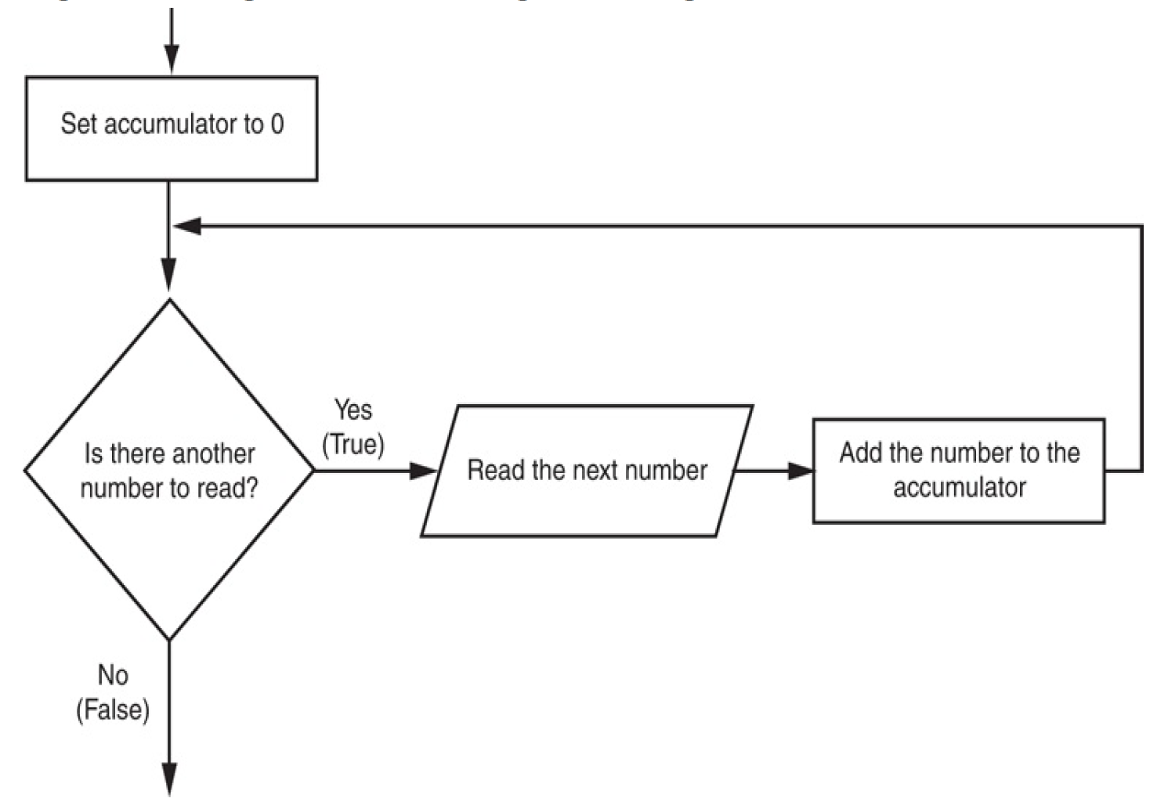
Repetition Structures
Repetition Structures: calculating running totals
To the right side: A general loop that calculates a running total.
When the loop finishes, the accumulator will contain the total of the numbers that were read by the loop.
Notice the first step in the flowchart is to set the accumulator variable to 0. This is a critical step.
Each time the loop reads a number, it adds it to the accumulator. If the accumulator starts with any value other than 0,it will not contain the correct total when the loop finishes.

Slide 11
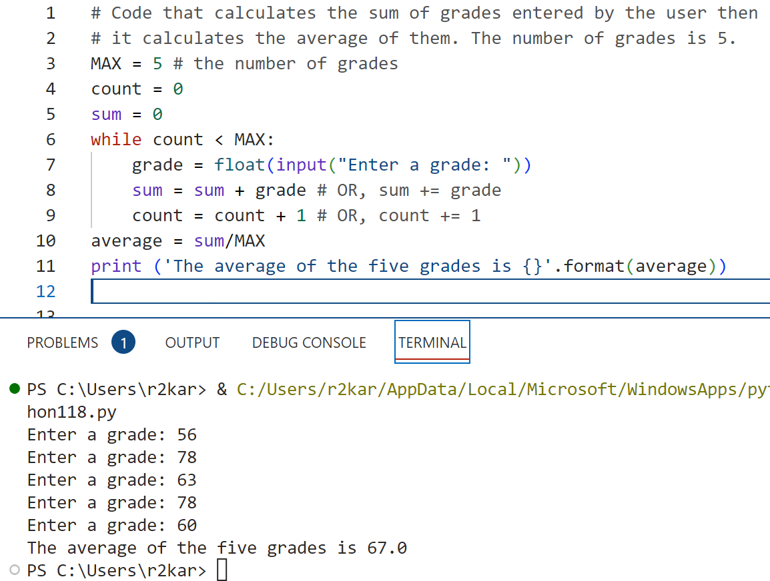
Repetition Structures
Repetition Structures: calculating running totals
In the example, first, we set MAX (the number of grades to be entered) to 5. We initialize the count and sum variables to 0 (or 0.0).
The while loop checks for count if it’s less than MAX so the loop keeps running for 5 times.
Inside the loop, we prompt the user to enter the grades, then we add the grades in every loop to the sum variable (the accumulator) – line 8.
We increment the counter – line 9 so the while condition gets evaluated in the next iteration.
When the loop finishes, the sum holds the total of the 5 grades, then the average is computed (outside the loop) and its value is printed out.

Slide 12
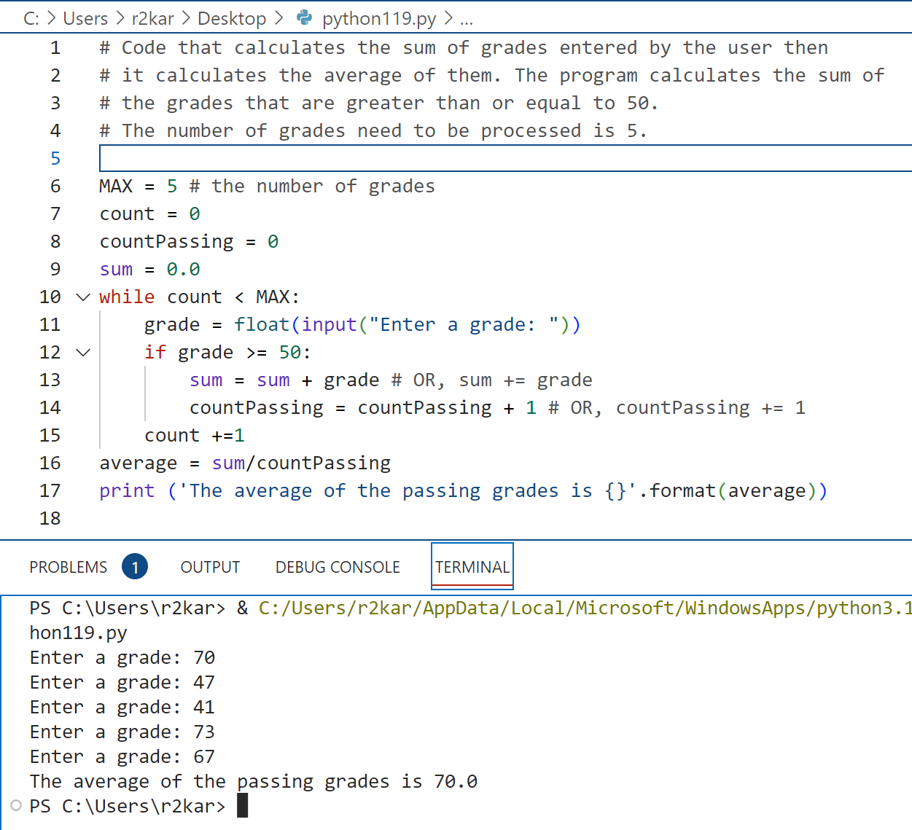
Repetition Structures
Repetition Structures: calculating running totals
In the example, we modified the code by checking for the grades if they are greater than or equal to 50 - line 12, the program calculates the sum and increments the counter for the passing grades (countPassing). The count variable keeps track the grades entered by the user. The countPassing keeps track only the grades that meet the condition in line 12.
The average is calculated for the passing grades – line 16

Slide 13
Repetition Structures
Repetition Structures: using Sentinel values
A sentinel is a special value that marks the end of a sequence of items. When a program reads the sentinel value, it knows it has reached the end of the sequence, so the loop terminates.
Usually, these values are determined by the programmer or based on a business model (client requirements).
For example, suppose a doctor wants a program to calculate the average weight of all her patients. The program might work like this: A loop prompts the user to enter either a patient’s weight, or 0 if there are no more weights. When the program reads 0 as a weight, it interprets this as a signal that there are no more weights. The loop ends and the program displays the average weight.
A sentinel value must be distinctive enough that it will not be mistaken as a regular value in the sequence.

Slide 14
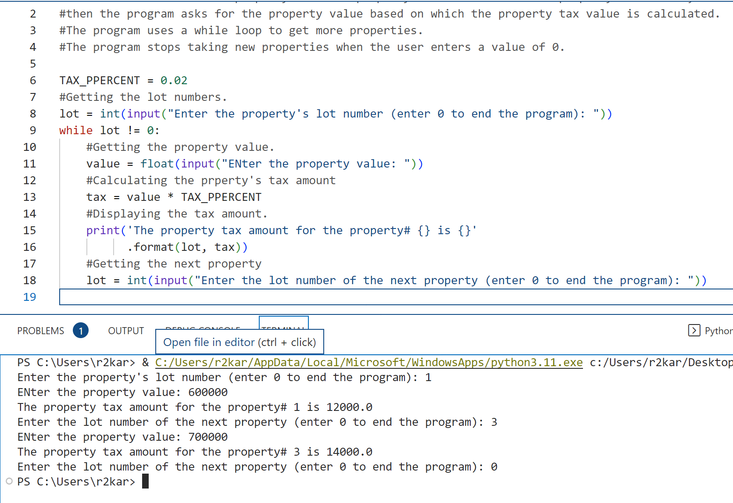
Repetition Structures
Repetition Structures: using Sentinel values
In the example, first, we set the TAX_Percent value to 0.02 (or any value you choose). The program prompts the user to enter a value for property’s lot – line 8. The loop checks for the lot value if it’s not equal to 0 – line 9. here, the variable lot is the sentinel.
Inside the while loop, the program asks for the property value from the user- line 11. the property tax amount is calculated and printed out- lines 12-16.
Then the program prompts the user to enter the lot number of the next property, so the while loop checks for the lot number-line 9. The program keeps going calculating the property taxes as long as the user does not enter 0 for the lot variable. The program ends when the user enters 0.

Slide 15
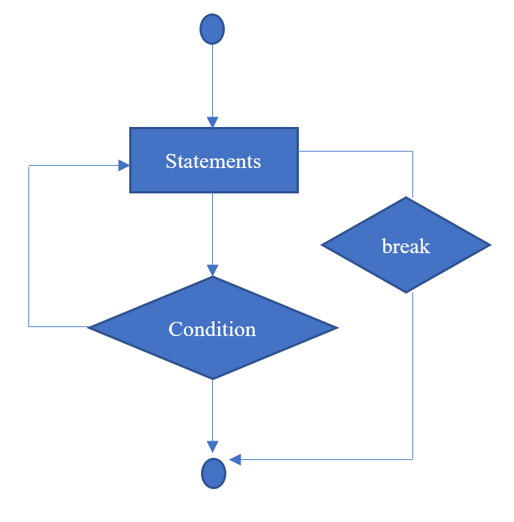
Repetition Structures
Repetition Structures: the break and continue statements
The break and continue statements give you additional control over loops.
The break statement breaks out of a loop by causing program execution to jump to the statement that follows the loop. This causes the loop to end. The continue statement continues a loop by causing execution to jump to the top of the loop. This causes the loop to execute again by reevaluating its condition.

Slide 16
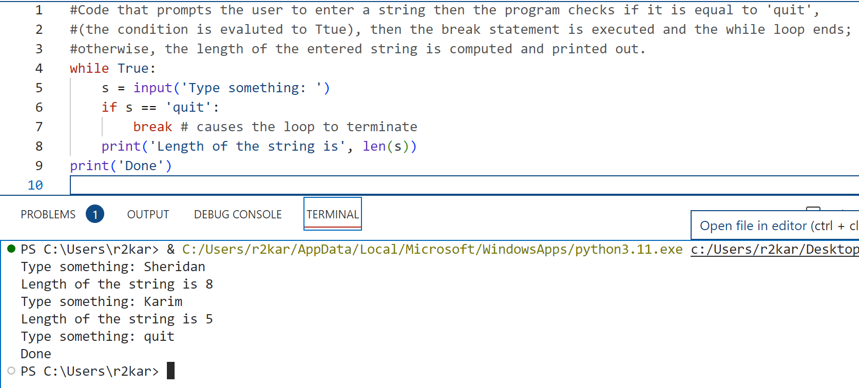
Repetition Structures
Repetition Structures: Example for the break statement
The while loop condition is always True so the loop is infinite. Inside the loop, the program prompts the user to enter a string –line 5. it checks for the string if it is equal to ‘quit’ (it evaluates the condition) so the break statement is executed, and the while loop terminates. This breaks out of the current loop and executes the statement that follows the loop, that is line 9.

Slide 17
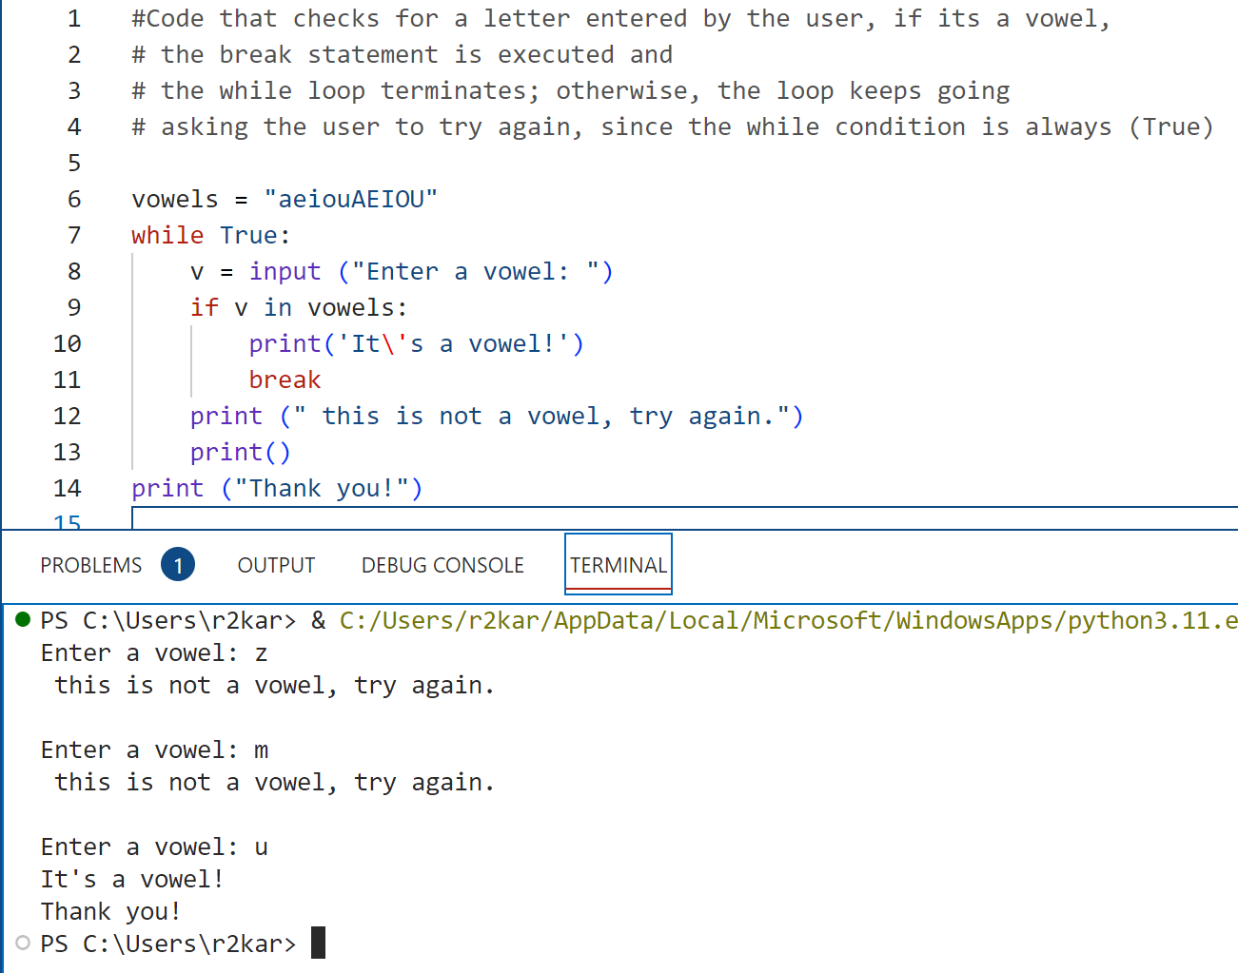
Repetition Structures
Repetition Structures: Example for the break statement
The while loop condition is always True so the loop is infinite. Inside the loop, the program prompts the user to enter a letter –line 8. it checks if it’s a vowel by evaluating the if statement. If its true the program prints (‘ it’s a vowel ’) and the while loop terminates with the break statement (line 11), and the rest of the program is executed (starting line 14); otherwise, the loop keeps going and prompts the user to try again.

Slide 18
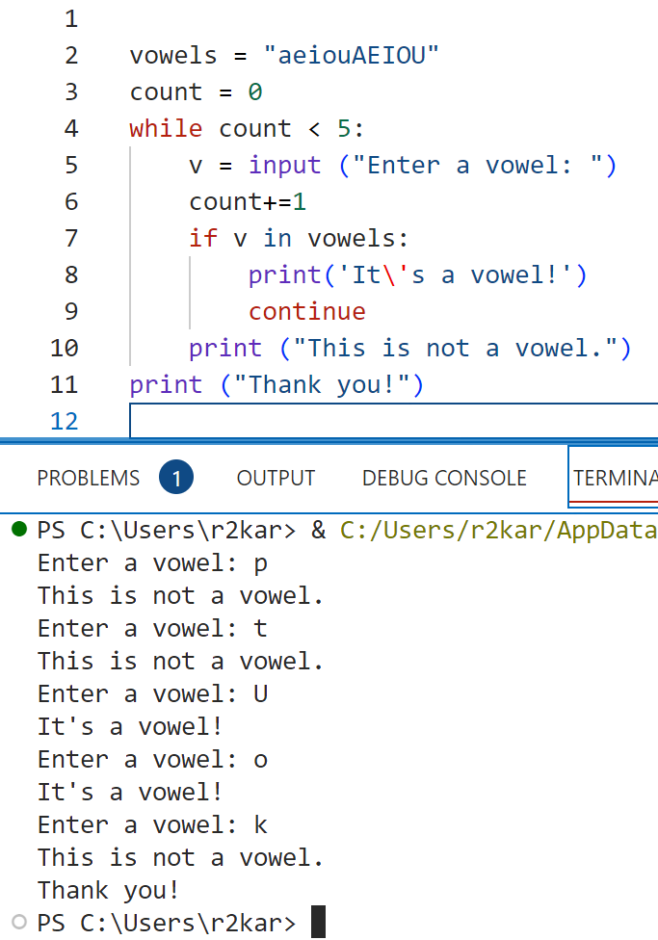
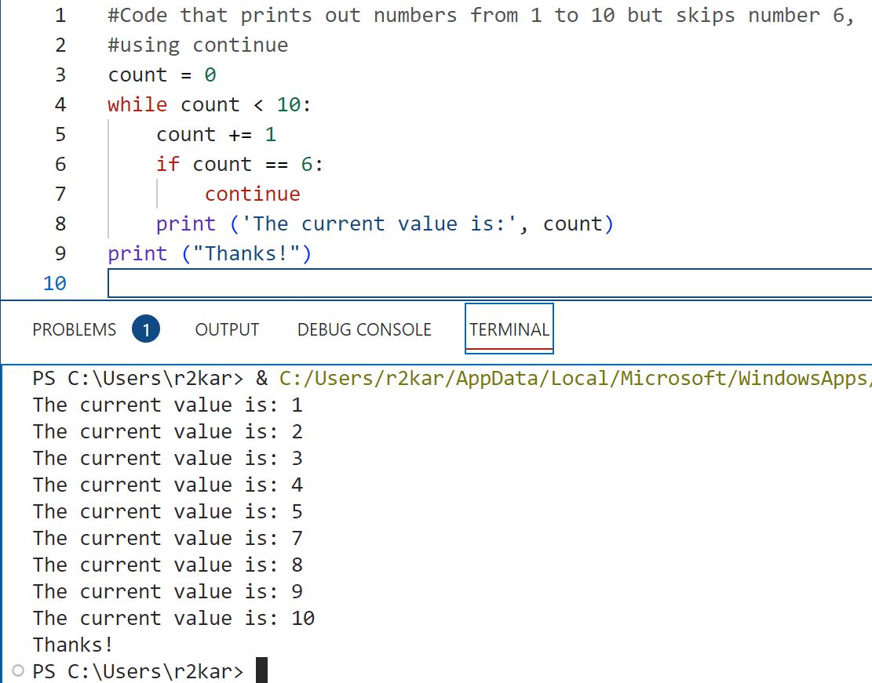
Repetition Structures
Repetition Structures: Example for the continue statement
To the left, a modification to the vowel example. We allow the user to try 5 times by entering 5 letters. The program checks if the letter entered is a vowel; if so, it prints a message (line 8), and jumps to the start of the loop. If it’s not a vowel, it prints another message (line 10). The program keeps going for 5 times.
To the right, the code uses continue to jump to the start of the loop to increment count and continues.

Slide 19
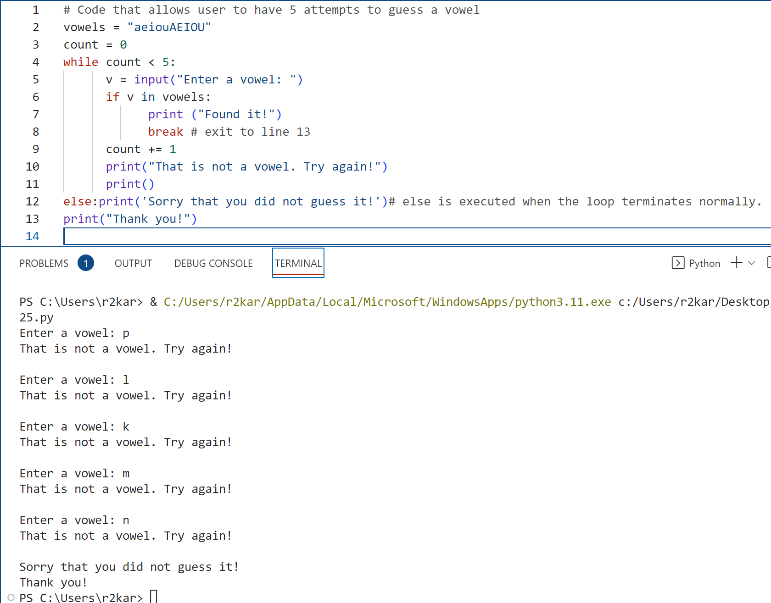
Repetition Structures
Repetition Structures: using else with loops
Warning ! You will never see this in any other programming languages.
Using else clause with a loop (while or for) is a unique thing to Python.
The else is used with a while loop. The else statement is executed when the condition is evaluated false.
The else statement is not executed if the loop terminates with break.
In the example, the else statement (line 12) is executed ONLY when the loop is completed with five iteration, with no termination by the break in line 8. If the break is executed, which only happens if ( v is in vowels ), the control moves to line 13, skipping the else statement.
The else with loops: provides an additional control for programmers to use to support their logic in solving problems, if needed.

Slide 20
Data Types- Lists
Repetition Structures : Do it yourself !
Write a python program that calculates the area and the perimeter of a circle. Prompt the user to enter both values in a single input statement separated with ( ; ).
The program should validate the user inputs before the calculation, so all values are greater than 0.
The program prints out the area and the perimeter values

Slide 21
Data Types- Lists
Repetition Structures : Do it yourself !
Write a python program that calculates the value of miles per gallons (mpg) for a vehicles. The program validates the value of miles so it is greater than 0 and less then 1000.0; the value of gallons must be greater than 0.
Your program output should look like the following:
miles gallons mpg
210.0 2.5 ?

Slide 22
Data Types- Lists
Repetition Structures : Do it yourself !
Write a python program to calculate the average weight of all her patients. The program might work like this: A loop prompts the user to enter either a patient’s weight, or 0 if there are no more weights. When the program reads 0 as a weight, it interprets this as a signal that there are no more weights. The loop ends and the program displays the average weight.

Slide 23
Data Types- Lists
Repetition Structures : Do it yourself !
Write a python program to calculate the average weight of all her patients. The program might work like this: A loop prompts the user to enter either a patient’s weight, or 0 if there are no more weights. When the program reads 0 as a weight, it interprets this as a signal that there are no more weights. The loop ends and the program displays the average weight.

Slide 24
Data Types- Lists
Repetition Structures: Do it yourself !
A user has to guess a number between a range of 1 to n. The player inputs his guess. The program informs the player, if this number is larger, smaller or equal to the secret number, i.e. the number which the program has randomly created. If the player wants to gives up, he or she can input a 0 or a negative number. Hint: The program needs to create a random number. Therefore it's necessary to include the module "random".

Slide 25
Data Types- Lists
Repetition Structures: Do it yourself !
Modify the code in slide 15, by checking as well, if the length of the string entered by the user is less than 3; if so, it displays a message ‘the string entered is too small’. The program then jumps to the start of the loop to continue

Slide 26
More Data Types: Tuples and Dictionaries Part - 2

Slide 27
Data types: Tuples
Working with Tuples:
A tuple is a sequence that works much like a list. As a result, you can use many of the same skills that you learned for working with lists when you’re working with tuples.
The difference is that tuples are immutable, so they can’t be changed. As a result, you can’t use any of the skills for adding, modifying, or removing items.
Creating a tuple:
To create a tuple, you use a syntax that’s similar to the one for creating a list.
The difference is that you use parentheses to enclose the items in a tuple, not brackets.
Most of the time, you’ll need to create tuples that contain multiple items; however, if you need to create a tuple that contains a single item, you must follow that item with a comma like this:
scores = (99,)
This creates a tuple named scores that contains one int value. Without the comma, this code would not create a tuple. Instead, it would create an int value.

Slide 28
Data types: Tuples
Working with Tuples:
To access the items in a tuple, you use indexes within brackets, just as you do for the items in a list. However, since a tuple is immutable, you can only use this syntax to get items, not to set them.
You can unpack the items in a tuple by using a multiple assignment statement. To do that, you code as many variables as there are items in the tuple and then assign the tuple to those items.
Because tuples are immutable, they are more efficient than lists. As a result, you should use a tuple whenever you know the items won’t be changed. It is also a reason that makes tuple more secured than list since tuple’s items can not be altered.

Slide 29
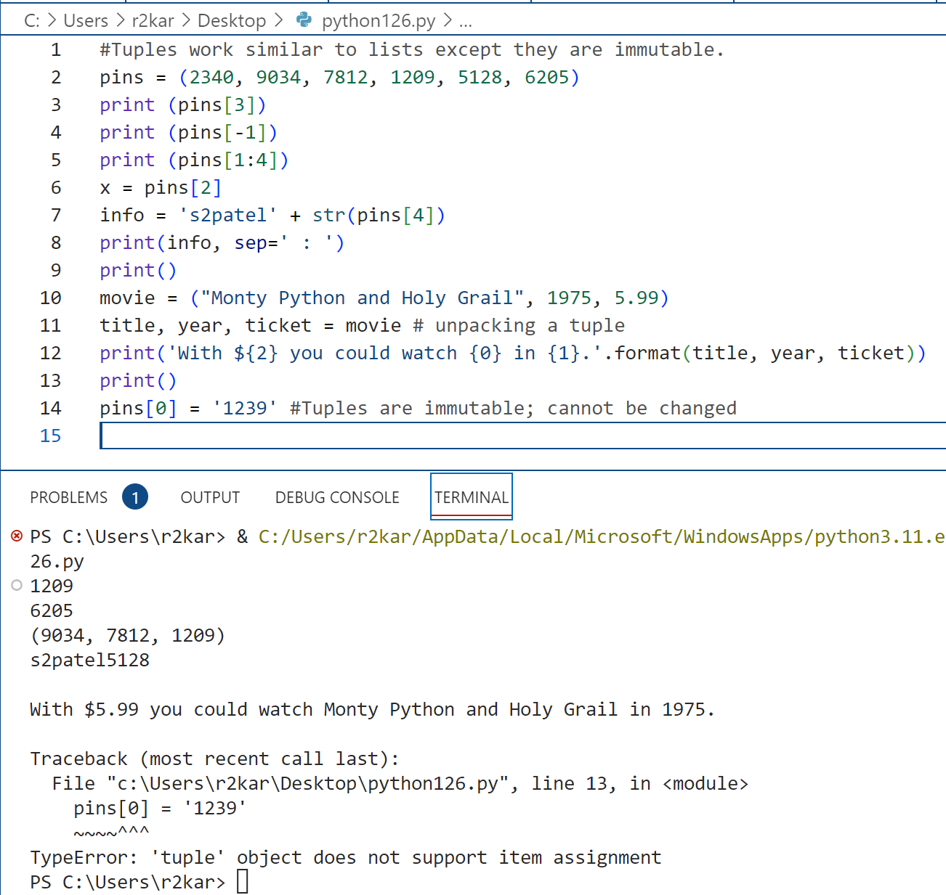
Data types: Tuples
Working with Tuples: Example

Slide 30

Data types: Dictionaries
Working with Dictionaries:
Like a list, a dictionary stores a collection of items. However, a list stores a collection of ordered items, and a dictionary stores a collection of unordered items.
In other words, when you work with a list, the items always stay in the sequence in which you insert them. That’s why a list is known as a sequence.
However, when you work with a dictionary, the items typically don’t stay in the sequence in which you insert them.

Slide 31
Data types: Dictionaries
Working with Dictionaries:
To create a dictionary, you enclose the dictionary inside braces ( { }) . Within these braces, each dictionary entry consists of a key, followed by a colon, and a value that corresponds to the key.
This is known as a key/value pair. In other words, unlike lists, which are accessed by an integer index, dictionaries are accessed by a key that’s typically a string but can be any immutable data type.
Each value in the dictionary is indexed by a unique key.
The key can be any immutable data type, but it’s usually a string.
The value that corresponds to a key can be a simple data type such as number or a string. Or, it can be a complex data type such as a list or another dictionary.
Whitespace is ignored between dictionary items. As a result, you can use whitespace to format a dictionary so the code is easier to read.

Slide 32
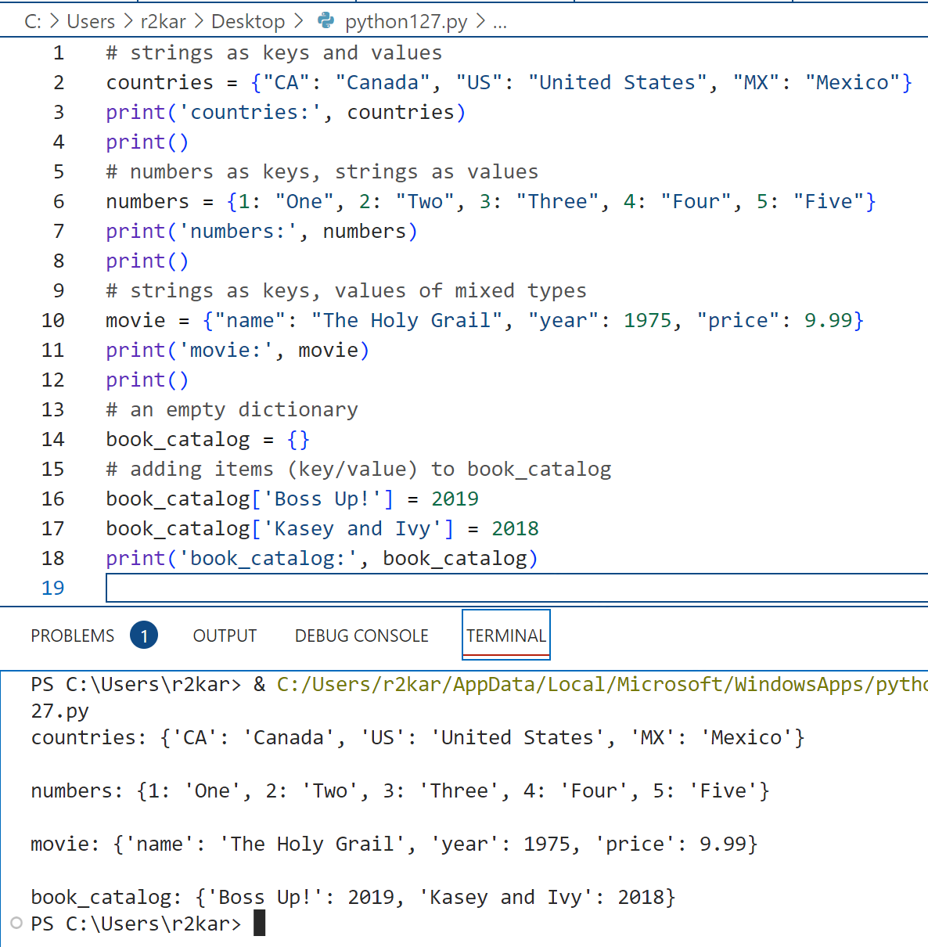
Data types: Dictionaries
Working with Dictionaries: Example(1)

Slide 33
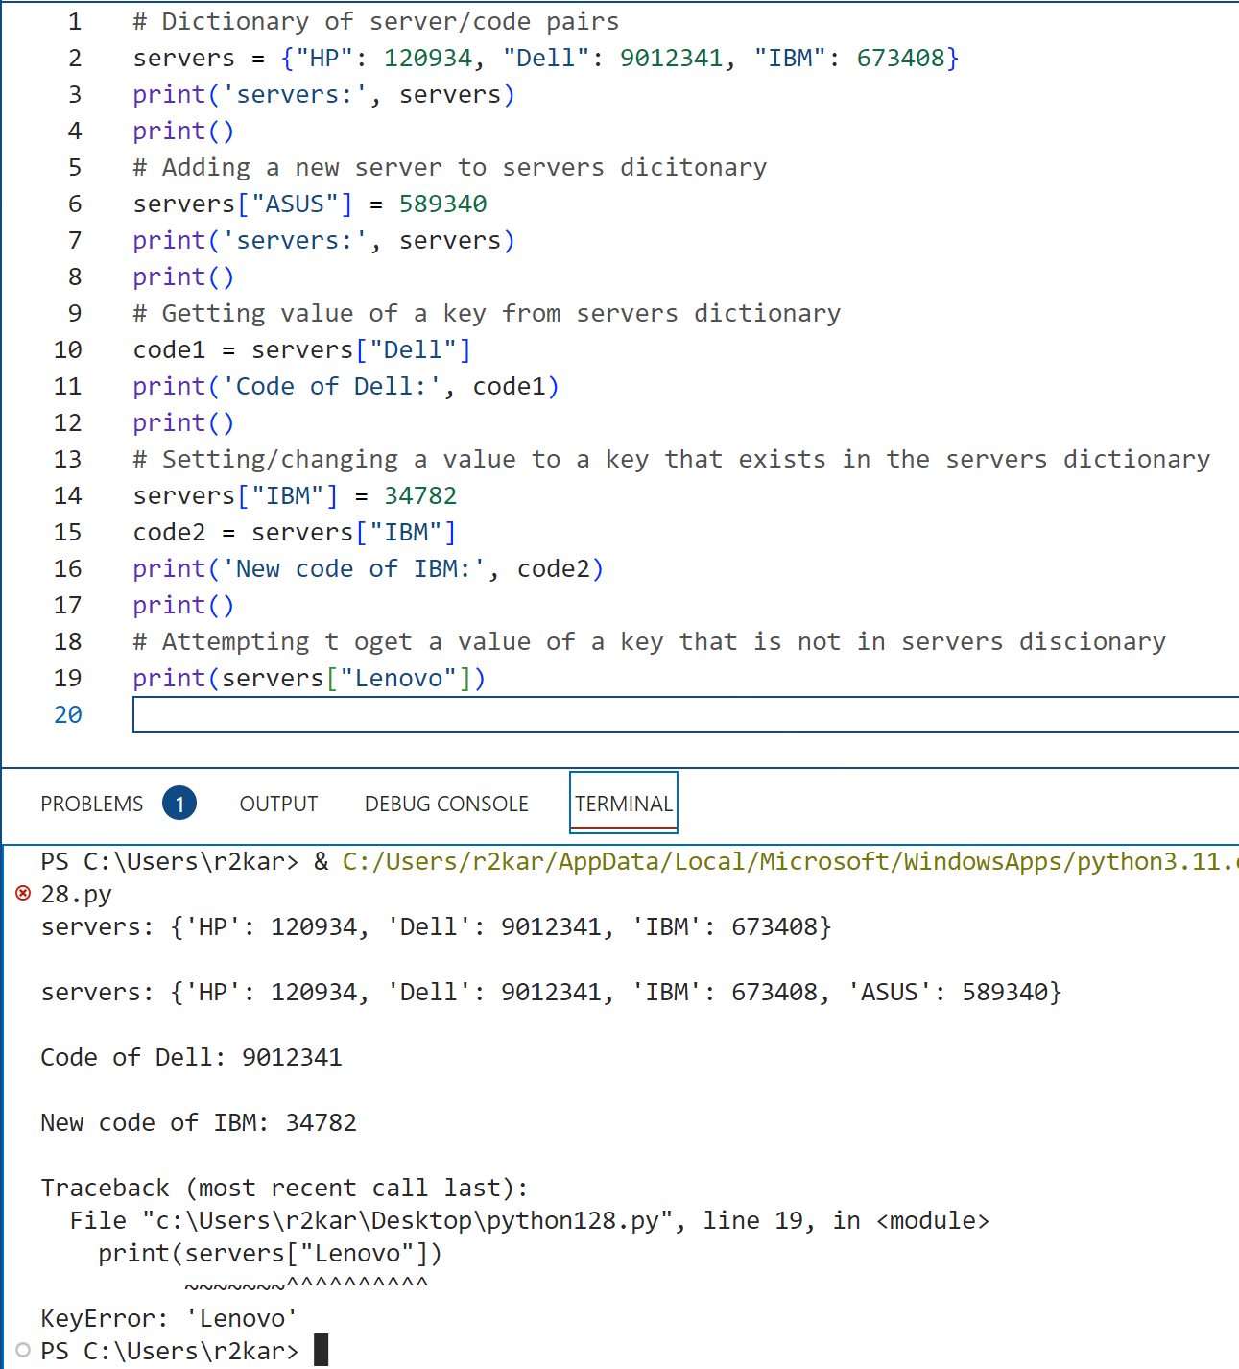
Data types: Dictionaries
Working with Dictionaries: Example(2)

Slide 34
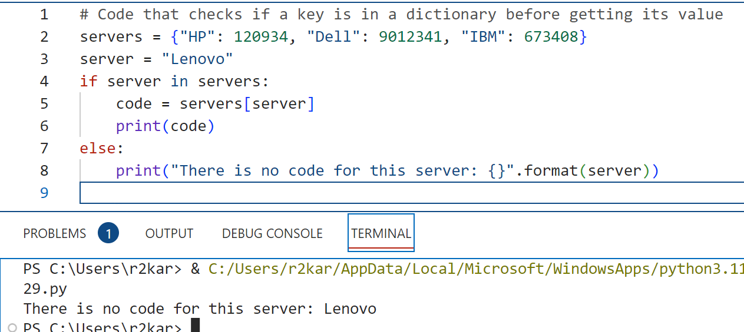
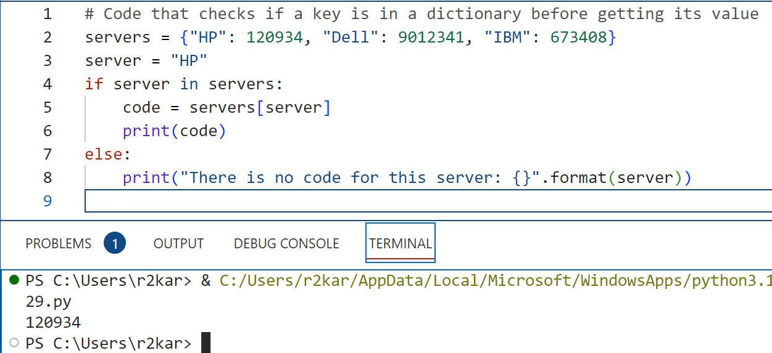
Data types: Dictionaries
Working with Dictionaries: Example(2)

Slide 35
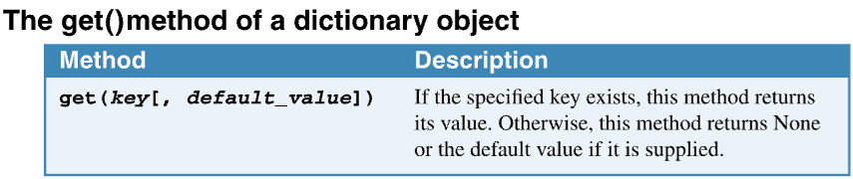
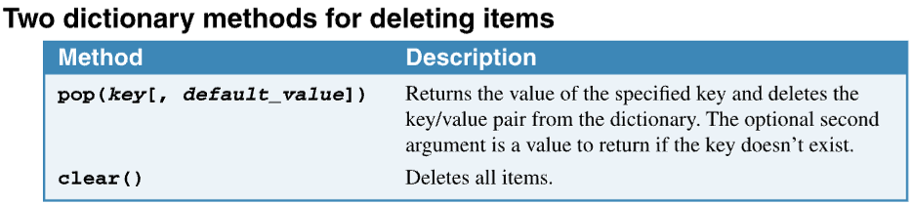
Data types: Dictionaries
Working with Dictionaries: Dictionary methods
Attempting to get a value for a key that isn’t in the dictionary causes a KeyError.
To prevent a KeyError from occurring, you can use the get() method of a dictionary.
To delete items from a dictionary, you can use the del keyword or the pop() and clear() methods.

Slide 36
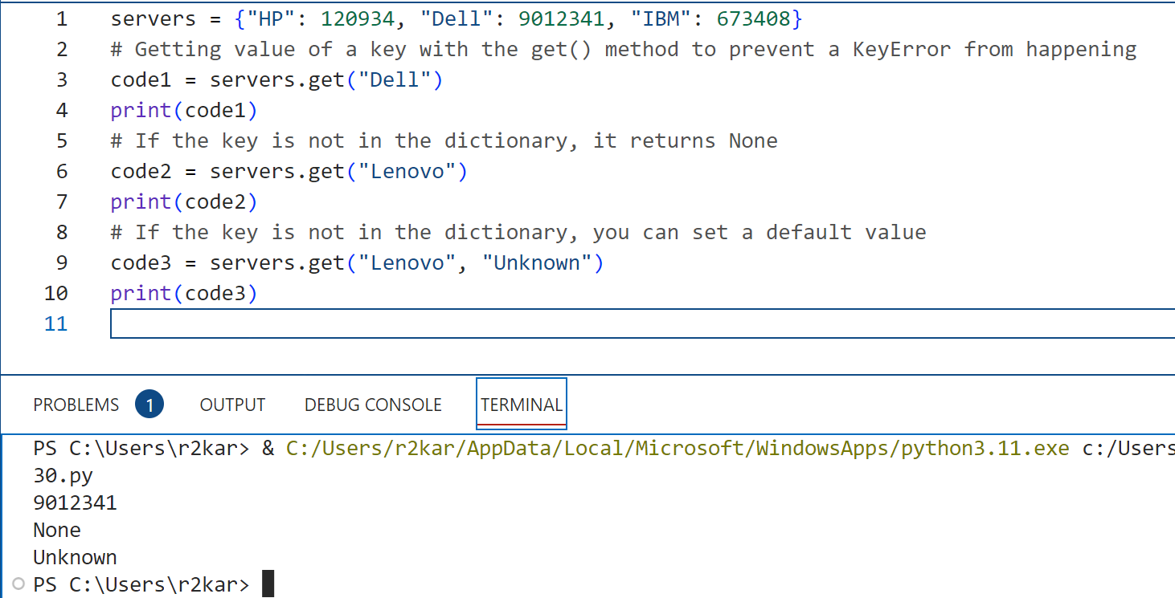
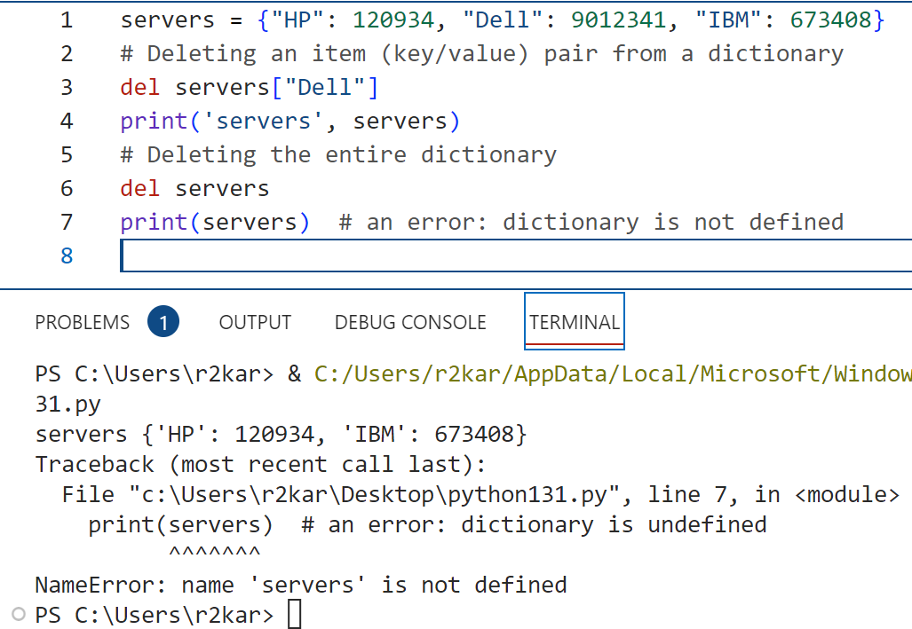
Data types: Dictionaries
Working with Dictionaries: Examples of Dictionary methods

Slide 37
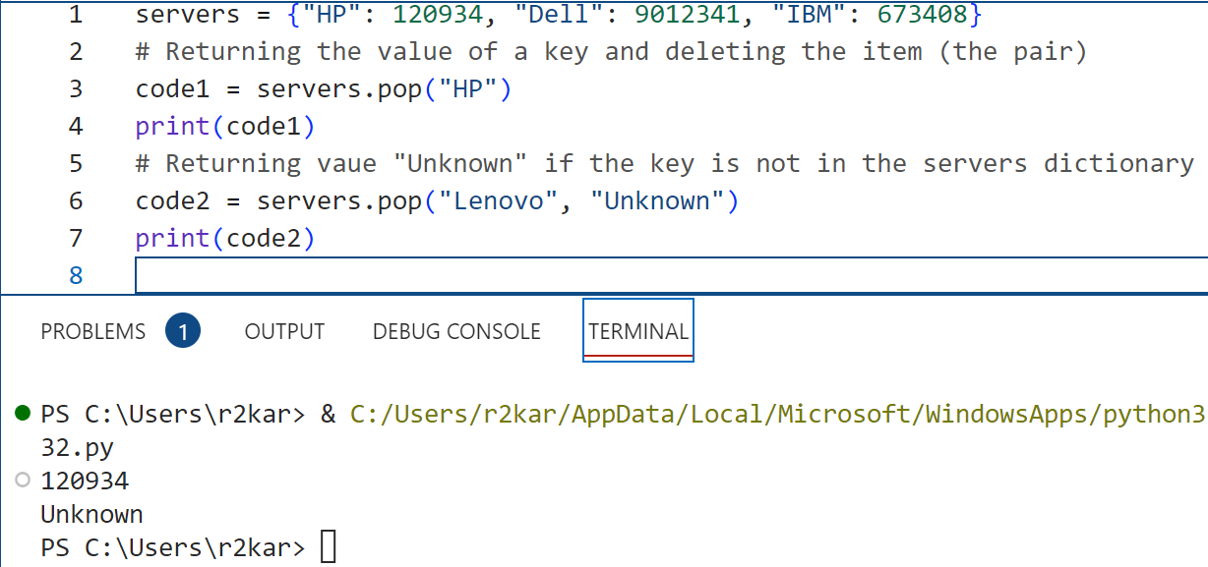
Data types: Dictionaries
Working with Dictionaries: Examples of Dictionary methods

Slide 38
Data Types
Tuples and Dictionaries: Do it yourself !
Write a python program to check if a course code is in the dictionary courses before deleting it; if so, it will be deleted and a message (‘ The course is deleted.’) is displayed to the user; otherwise, a message (‘ There is no course for this code’) is displayed.
The program starts with an empty courses dictionary and a few items are added later.
It prompts the user to enter a code to check for.

Slide 39
Data Types
Tuples and Dictionaries: Do it yourself !
Create two Python dictionaries: English to Spanish and Spanish to German. Use online dictionaries on the internet to build these dictionaries of a few items in each.
Write code that prompts the user to enter a word in English then your program should translate it into German using the two dictionaries you built.

Slide 40
References
Material has been taken from (can be accessed through Sheridan's Library Services) :
Starting Out with Python (ISBN-13: 9780136912330 ):
https://www.pearson.com/en-ca/subject-catalog/p/starting-out-with-python/P200000003356/9780136912330
Murach’s Python 2nd Edition programming, 2nd Edition :
https://bookshelf.vitalsource.com/reader/books/9781943872756/pages/recent
Introducing Python, Lubanovic, B., O'Reily Media, 2nd Edition, 2019
https://www.oreilly.com/library/view/introducing-python-2nd/9781492051374/

